Slide 1
STANCE DETECTION FOR COVID-19
Suto Robert-Lucian, Drobnițchi Daniel-Nicușor

Slide 2
01
02
03
Introduction
Exploratory Data Analysis
Pre-Processing
04
05
Prediction & Models
Conclusions
Short Introduction
Analyzing data patterns to gain initial insights.
Preparing text data for NLP analysis tasks.
Making accurate predictions iteratively.
Conclusions about our work

Slide 3
Scope of the project
This project focuses on stance detection in COVID-19 tweets, aiming to classify them into two three categories: Supportive, Critical and Neutral. By employing advanced natural language processing techniques, we seek to gain insights into public opinion and sentiment surrounding the COVID-19 pandemic.

Slide 4
02
EXPLORATORY DATA ANALYSIS
You can enter a subtitle here if you need it

Slide 5
DATASET
44955 total unique tweets
4 Columns
Approximated test-train split of
10%-90%
Location, TweetAt, OriginalTweet, Sentiment

Slide 6
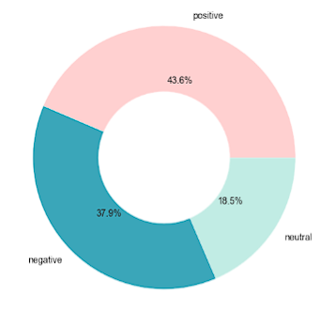
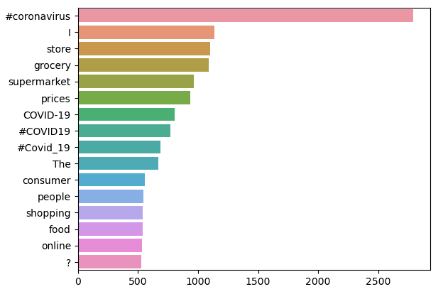
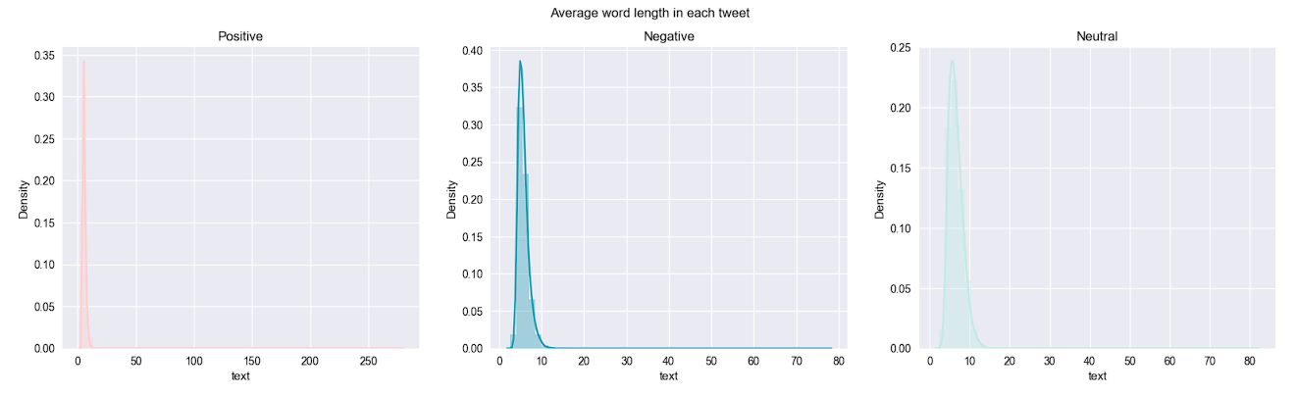
Data analysis

Slide 7
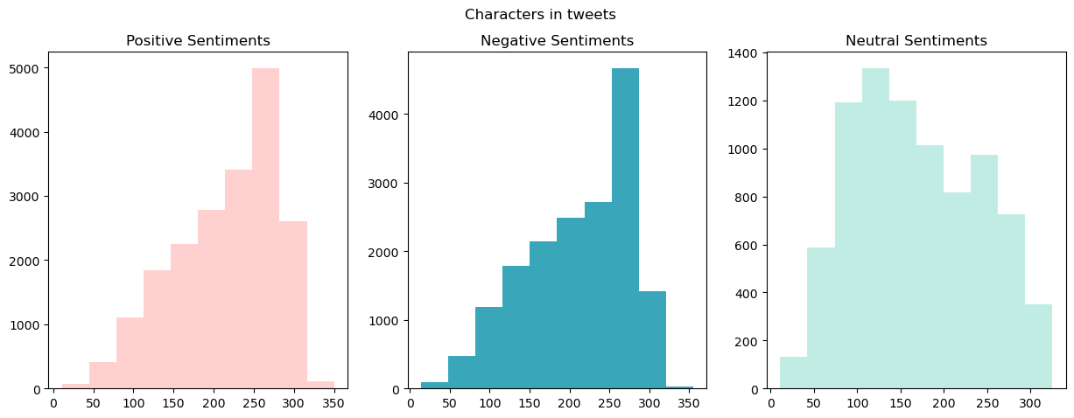
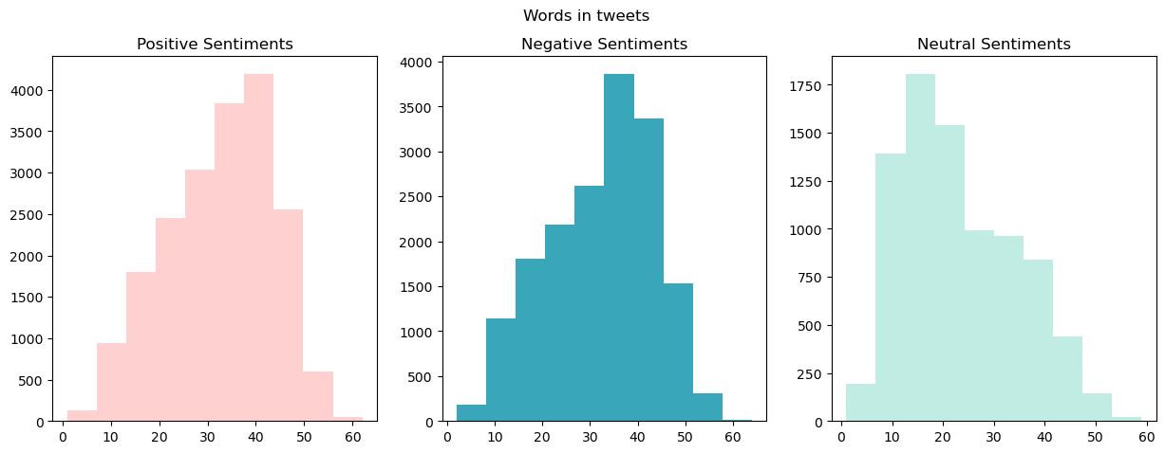

Slide 8
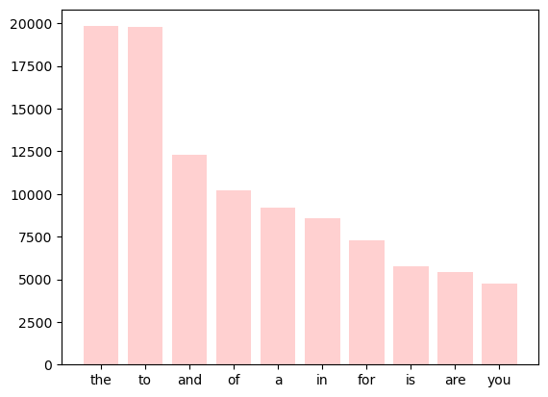
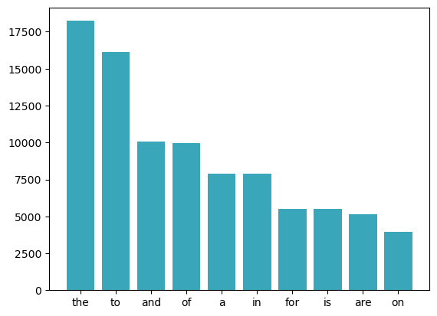
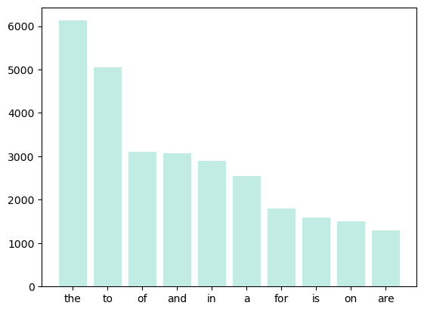
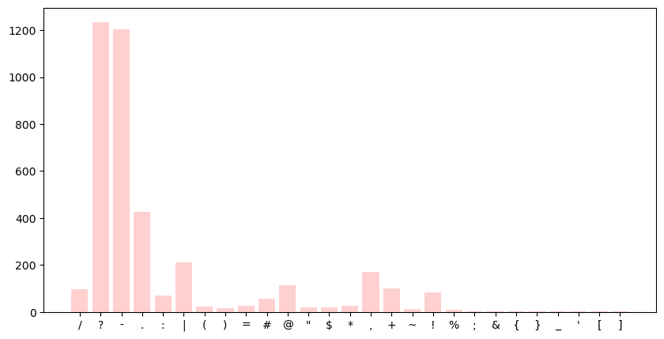
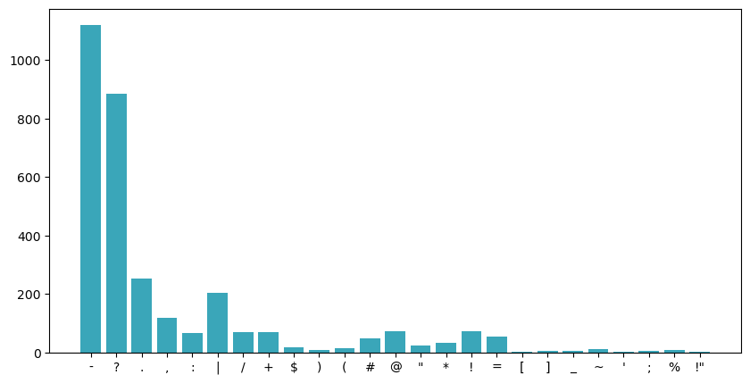
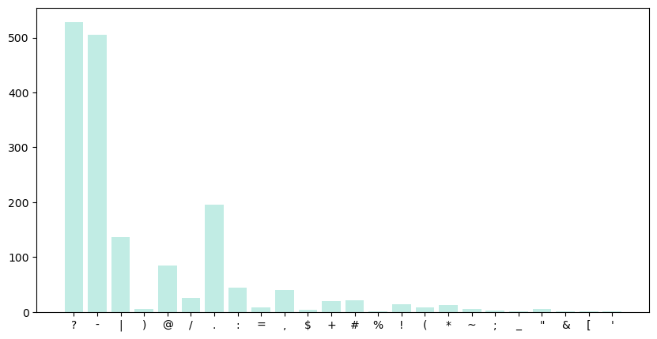

Slide 9
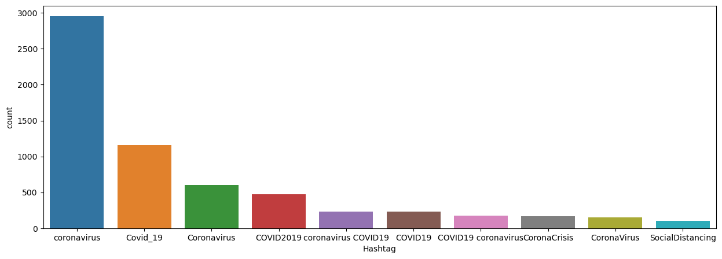
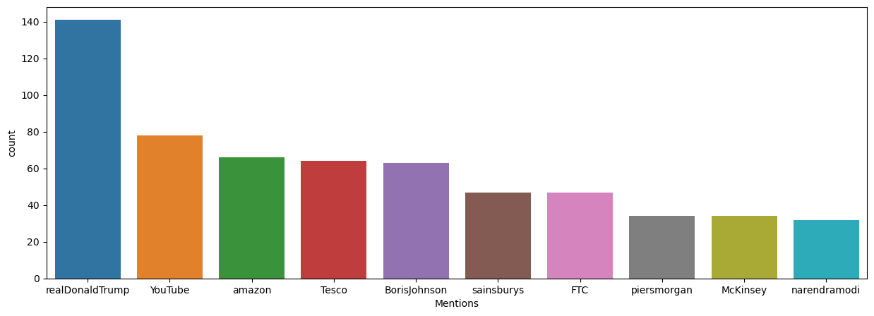

Slide 10
03
Pre-processing
Preparing text data for NLP analysis tasks.

Slide 11
Pre-processing
Remove emojis, punctuations, links, mentions and new line characters.
Clean Hashtags, filter special characters.
Remove multiple spaces.
Remove tweets that are not written in english, remove tweets that are too long.
One-hot encode.
Vectorize using TF-IDF.

Slide 12
04
Prediction & Models
You can enter a subtitle here if you need it

Slide 13
Models used
XgBoost
BERT
MultiNomial Naive Bayes
High-performance gradient boosting with strong predictive capability.
Bidirectional Encoder Representations from Transformers, a state-of-the-art language model for natural language processing tasks.
Probabilistic text classifier assuming feature independence for efficient and accurate classification.

Slide 14
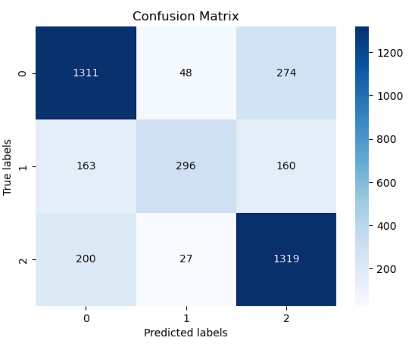
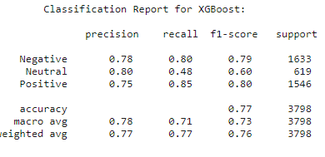
XGBoost

Slide 15
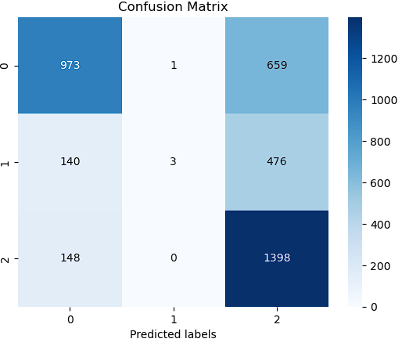
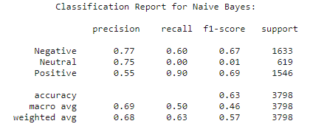
MultiNomial Naive Bayes

Slide 16
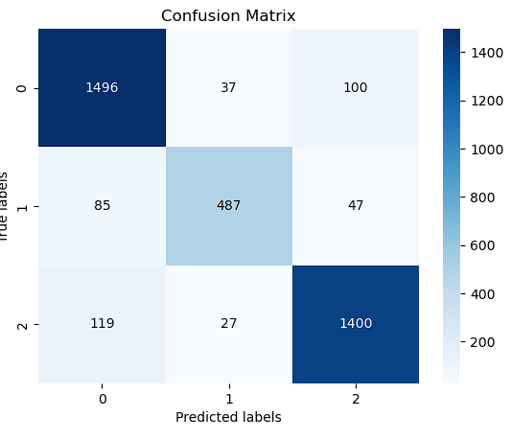
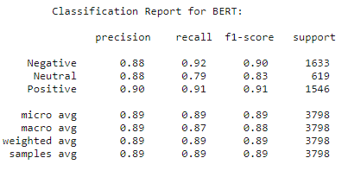
BERT

Slide 17
05
Conclusions
In a diverse world of opinions, understanding public stance on pressing issues like the coronavirus is crucial. Using Natural Language Processing, our project analyzed tweets to uncover the global pandemic's stance. Three models - XGBoost, Bert, and Multinomial Naive Bayes - were utilized, with the following accuracy scores: Bert (0.9), XGBoost (0.865), and Multinomial Naive Bayes (0.72). Our findings offer insights into public opinion and open doors for future research.

Slide 18
THANKS!

